Slide 2
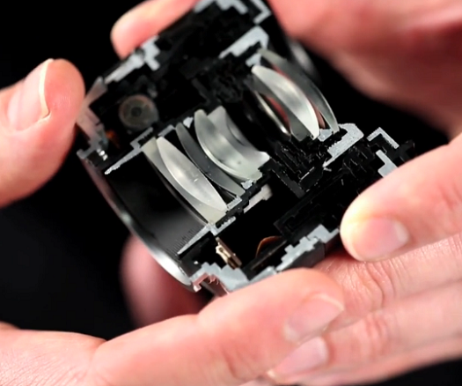
http://sonyalphanex.blogspot.com/

Slide 3
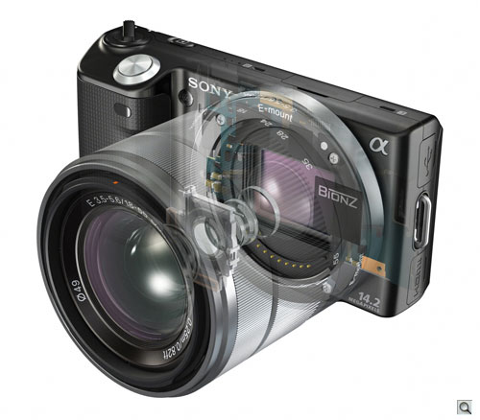
http://www.imaging-resource.com/PRODS/NEX5/NEX5A.HTM

Slide 4
I₁
O₂
f₁
f₂
O₁
f₁
f₂
I₂
s₁
s’₁
s₂
s’₂
d
f₁
f₂

Slide 5
Combination of Lenses
I₂
I₁ O₂
f₁
f₂
O₁
f₁
f₂
s₁
s’₁
s₂
d
f₁
f₂
s’₂

Slide 6
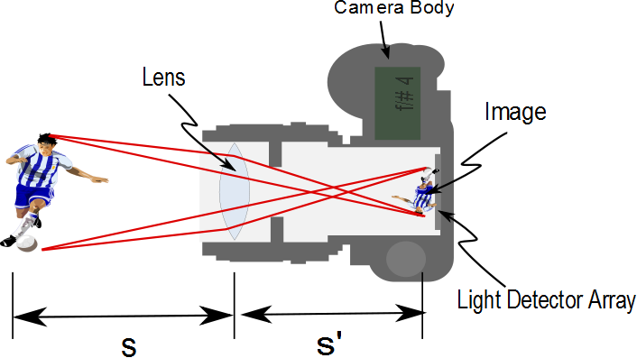
Aperture

Slide 7
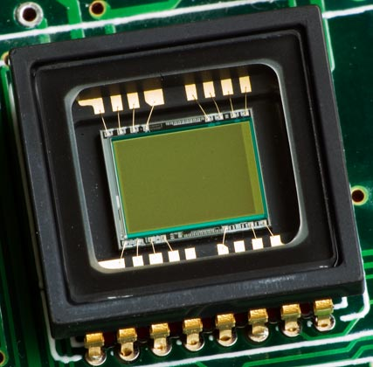

Slide 8
Say we wish to take a picture of Aunt Sally. Aunt Sally is about 1. 5m tall. She is standing about 5m away. Then to fit the image of Aunt Sally on our 35mm detector, we must have
h=1.5m
h′=0.035m
s=5m
f=0.058m
find s′ and m.

Slide 9
Now suppose we want to photograph a 1000m tower from 2km away. Then to fit the image of our tower on our 35mm detector, we must have
h= 1000m
h′=0.035m
s= 2000m
f=0.058m
find s′ and m.

Slide 10
